Slide 1
22C:19 Discrete Structures Sets and Functions
Spring 2014
Sukumar Ghosh

Slide 2
What is a set?
Definition. A set is an unordered collection of objects.
S = {2, 4, 6, 8, …}
COLOR = {red, blue, green, yellow}
Each object is called an element or a member of the set.

Slide 3
Well known Sets
Well known sets
N = {0, 1, 2, 3 …} set of natural numbers
Z = {…, -2, -1, 0, 1, 2, …} set of integers
Z+ = {1, 2, 3, …} set of positive integers
R = the set of real numbers

Slide 4
Set builders
A mechanism to define the elements of a set.
S = {x | x ∈ N ⋀ x is odd ⋀ x <20}
This means, S = {1, 3, 5, 7, 9, 11, 13, 15, 17, 19}
Belongs to,
an element of

Slide 5
Venn diagram
e
i
a
o
u
The set V of vowels
The universal set U contains all objects under consideration

Slide 6
Sets and subsets
The null set (or the empty set} ∅ contains no element.
A ⊆B (A is a subset of B) if every element is also an element of B.
Thus
{0, 1, 2} ⊆ N, S ⊆ S,
∅ ⊆ any set
A ⊂ B (called a proper subset of B) if A ⊆B and A ≠ B
The cardinality of S (|S|) is the number of distinct elements in S.

Slide 7
Power Set
Given a set S, its power set is the set of all subsets of S.
Let S = (a, b, c}
power set of S = {∅, {a}, {b}, {c}, {a, b}, {b, c}, {a, c} {a, b, c}
Question. What is the cardinality of the power set of S?

Slide 8
Cartesian Product of Sets
Ordered pair. It is a pair (a, b) for which the order is important (unlike a set)
Example. The coordinate (x, y) of a point.
Cartesian Product of Set (Example)
A = {a1, a2, a3} B= {b1, b2}
A ⨉ B = {(a1, b1), (a1, b2), (a2, b1), (a2, b2), (a3, b1), (a3, b2)}

Slide 9
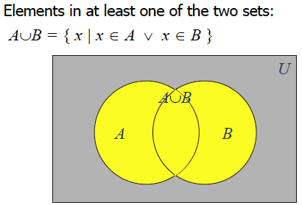
Union of Sets

Slide 10
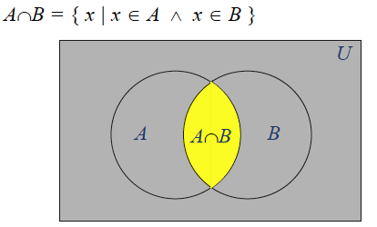
Intersection of Sets
Set of elements that belong to both sets

Slide 11
Union and Intersection
Let A = {1, 2, 3, 4, 5} and B = {0, 2, 5, 8}
Then A ⋃ B = {0, 1, 2, 3, 4, 5, 8} (A union B)
And A ⋂ B = {2, 5} (A intersection B)

Slide 12
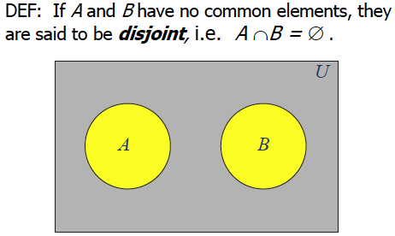
Disjoint Sets

Slide 13
Set difference & complement
Let A = {1, 2, 3, 4, 5} and B = {0, 2, 5, 8}
A – B = {x | x ∈A ∧ x ∉ B}
So, in this case, A – B = {1, 3, 4}
Also A = {x | x ∉ A}

Slide 14
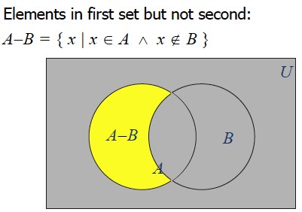
Set difference

Slide 15
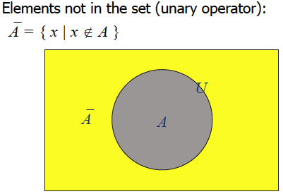
Complement

Slide 16
Set identities
Recall the laws (also called identities or theorems) with propositions (see page 24).
Each such law can be transformed into a corresponding law for sets.
Identity law
Domination law
Idempotent laws
Double negation
Commutative law
Associative law
De Morgan’s law
Absorption law
Negation law
Replace ⋁ by ⋃
Replace ⋀ by ⋂
Replace ¬ by complementation
Replace F by the empty set
Replace T by the Universal set U

Slide 17
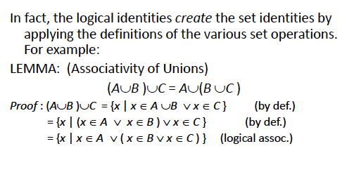
Example of set identity

Slide 18
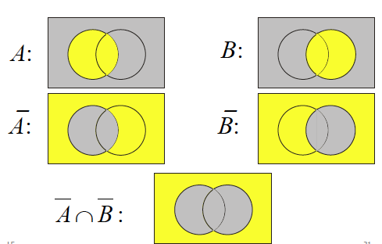
Visualizing DeMorgan’s theorem

Slide 19
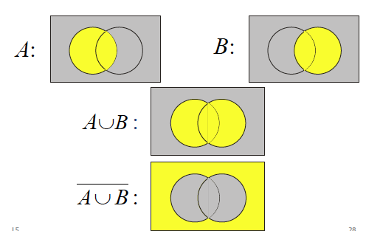
Visualizing DeMorgan’s theorem

Slide 20
Function
Let A, B be two non-empty sets. (Example: A = set of students,
B = set of integers). Then, a function f assigns exactly one element
of B to each element of A
f : A → B
(If we name the function f as age, then it “maps” one integer B to
each student, like age (Bob) = 19}
function
domain
Co-domain

Slide 21
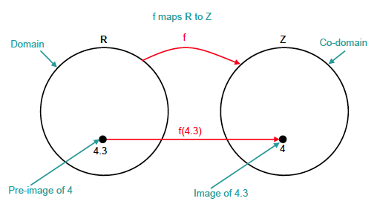
Terminology
Example of the floor function

Slide 22
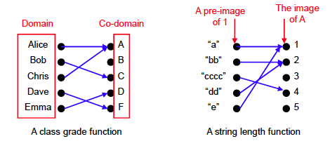
Examples

Slide 23
Exercises
Why is f not a function from R to R if
f(x) = 1/x
f(x) = x ^{½}
f(x) = ±(x² + 1) ^{½}

Slide 24
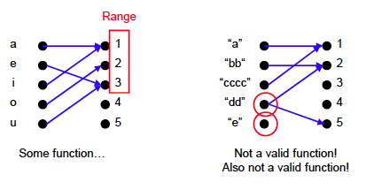
More examples
What is the distinction between co-domain and range?

Slide 25
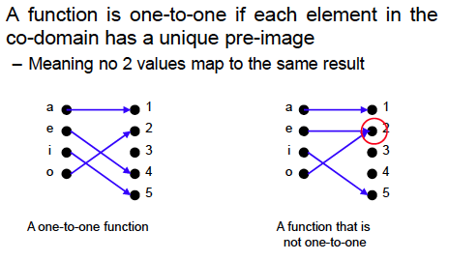
One-to-one functions
The term injective is synonymous with one-to-one

Slide 26
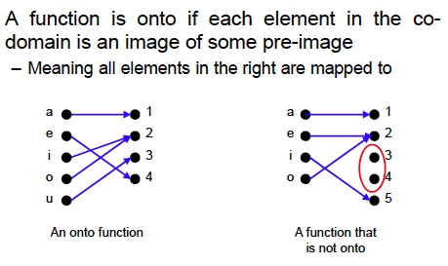
Onto Functions
The term surjective is synonymous with onto.

Slide 27
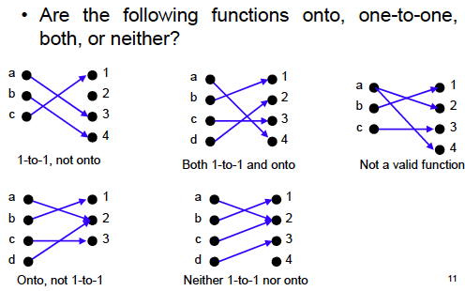
Exercise
1-to-1 and onto function are called bijective.

Slide 28
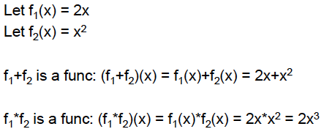
Arithmetic Functions

Slide 29
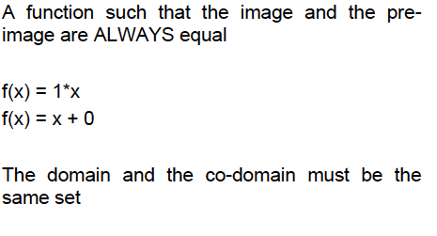
Identity Function

Slide 30
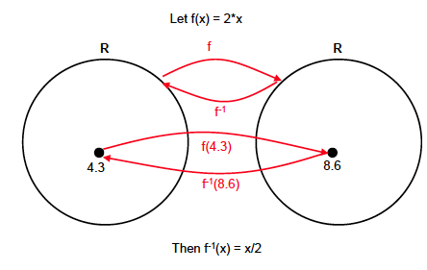
Inverse Function

Slide 31
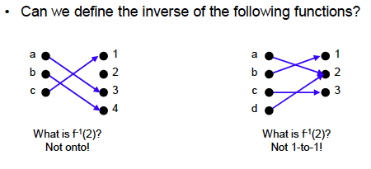
Inverse Function
Inverse functions can be defined only if the original function is
one-to-one and onto

Slide 32
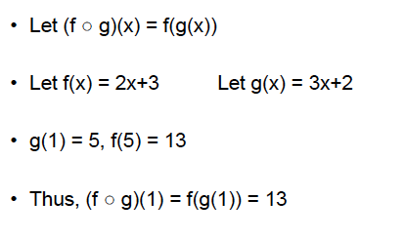
Composition of functions
Note that f(g(x) is not necessarily equal to g(f(x)

Slide 33
Some common functions
Floor and ceiling functions
Exponential function e^{x}
Logarithmic function log x
Learn about these from the book (and from other sources).

